Slide 1
ZOOM Meeting
Expectations

Slide 2
Review ZOOM Meeting Expectations
We see everything behind you, too!
You are being monitored!
Dress Appropriately! You’re at school.
Mute your microphone upon entering & wait for instructions.
Be thoughtful & considerate. Be your best self! Teachers, TAs, Parents, and sometimes younger siblings are watching and listening.
Violation of rules may get you muted, your video turned off, or booted!

Slide 3
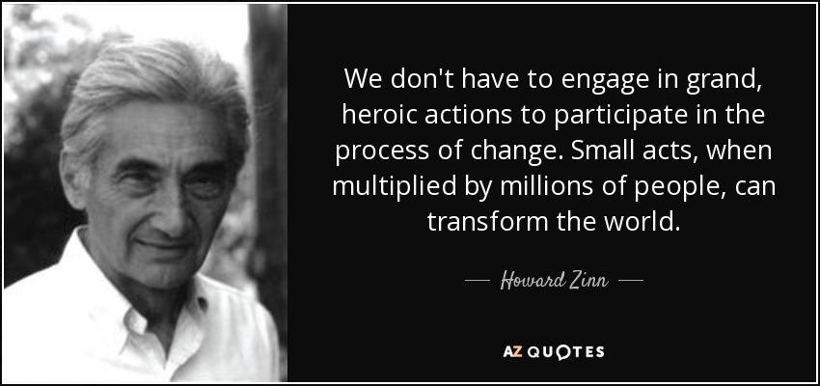
BREATHE

Slide 4
Common Questions

Slide 5
WHAT ABOUT DISCIPLINE?
This is your time to have my support.
Some Disciplinary Options:
The student is booted off Zoom.
Teacher calls the student’s parents.
The student has restricted access.
What about cheating on coursework?
The student earns a failing grade.

Slide 6
Attendance in Zoom Meetings?
NOT REQUIRED
It’s equivalent to a student walking up to the teacher’s desk and asking a question.

Slide 7
Grades?
All of your Language Arts and Math on grades are found inside APEX
All other classes will have their own gradebooks inside CANVAS.
If you’d like your learning to continue . . . please join us in Zoom Office Hours and make progress in your classes modules.

Slide 8
Try to be
a rainbow
in someone
else’s cloud.
- Maya Angelou

Slide 9
How will we stay in touch?
NO more Google Classroom
All Classes will be on CANVAS

Slide 10
I’m tired of having to remember all these places to login and having to login over and over and over and over...

Slide 11
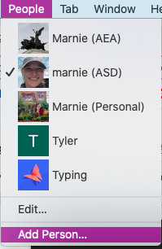
Google Chrome Browser
Add “PEOPLE” option
LINK to Google Chrome Help Page on this topic
First, click on PEOPLE in your Google Chrome browser.
Or, depending on device, go to ADD “people” or new user in your profile settings.

Slide 12
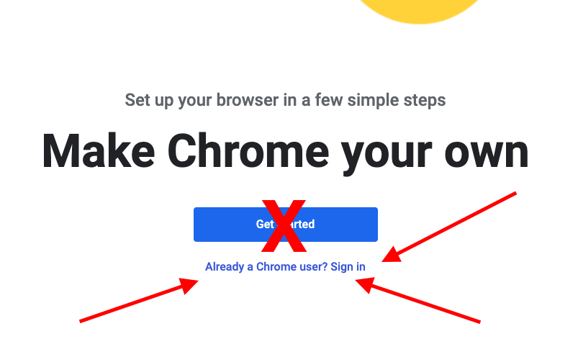
Click on the link “Already a Chrome User? Sign in”

Slide 13
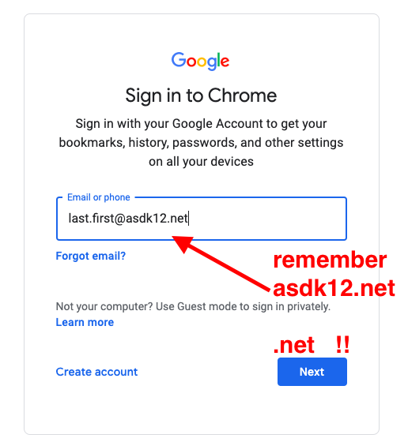
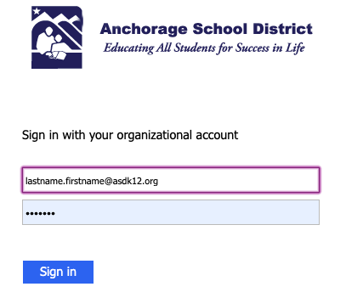
First, Login with last.first@asdk12.net
Then, Login with username and ID #

Slide 14
CLEVER

Slide 15
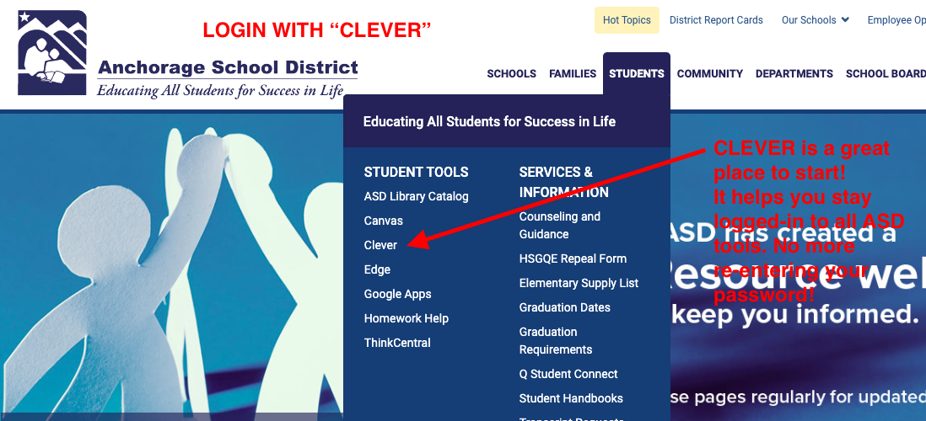
Go to asdk12.org then hover over STUDENTS tab, then click CLEVER

Slide 16
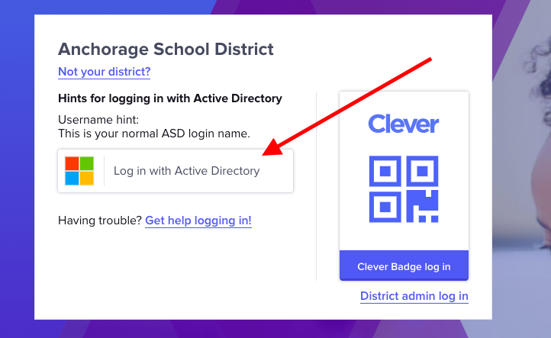
Click Log In with Active Directory

Slide 17
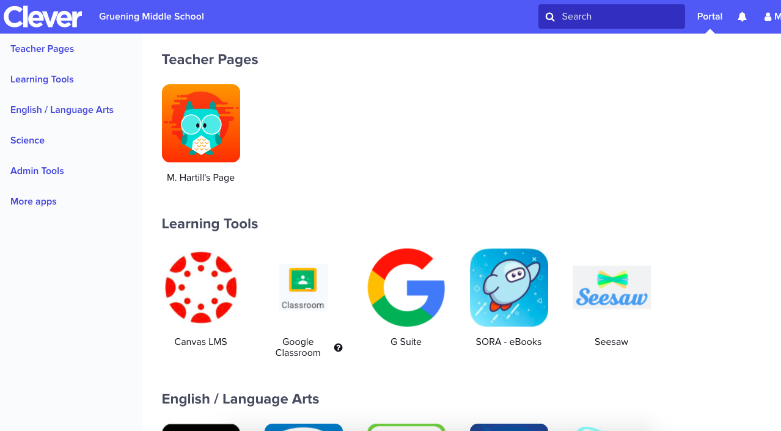

Slide 18
It is our attitude at the beginning of a difficult task which, more than anything else, will affect its successful outcome.
William James

Slide 19
CANVAS

Slide 20
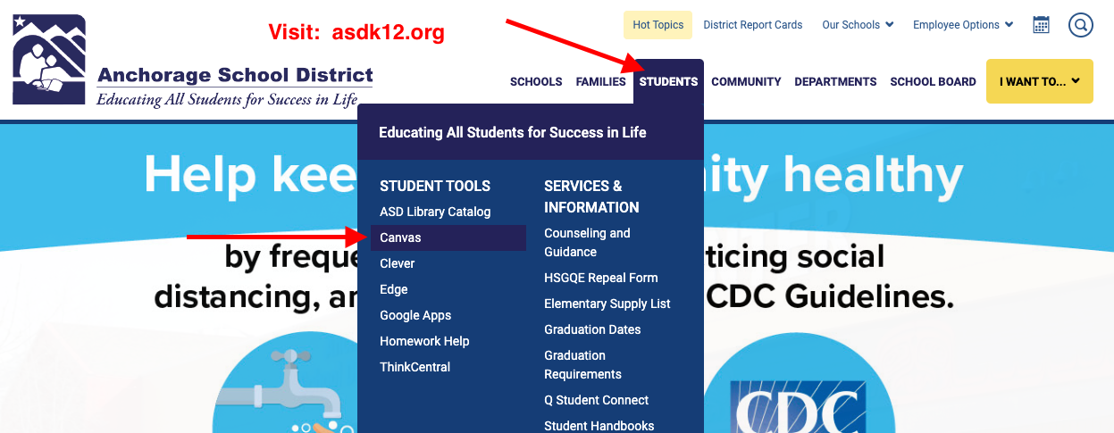
You can also find Canvas here:

Slide 21
At asdk12.org
Click on STUDENTS tab
Click on CANVAS
Login with your ASD username and password.
Usually your username is your last name (dot) your first name.
Usually your password is your ASD Student ID number.

Slide 22
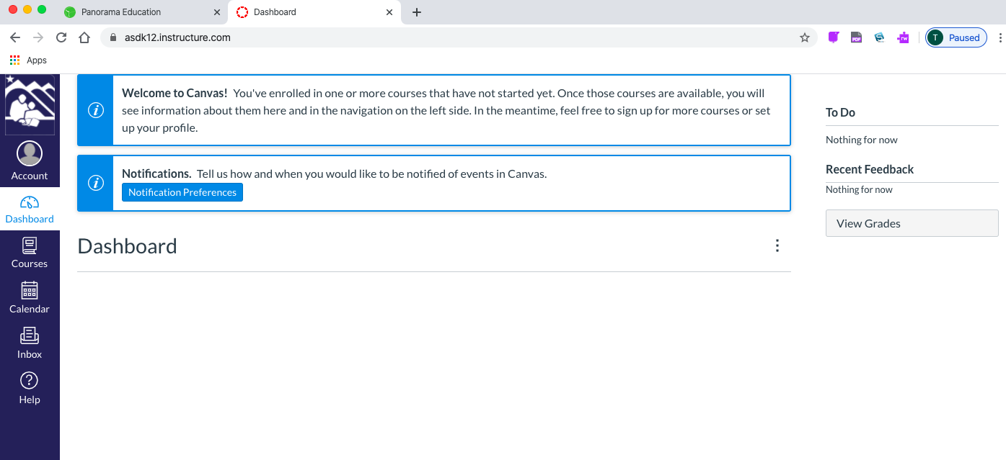
This is the first screen you will start with in CANVAS

Slide 23
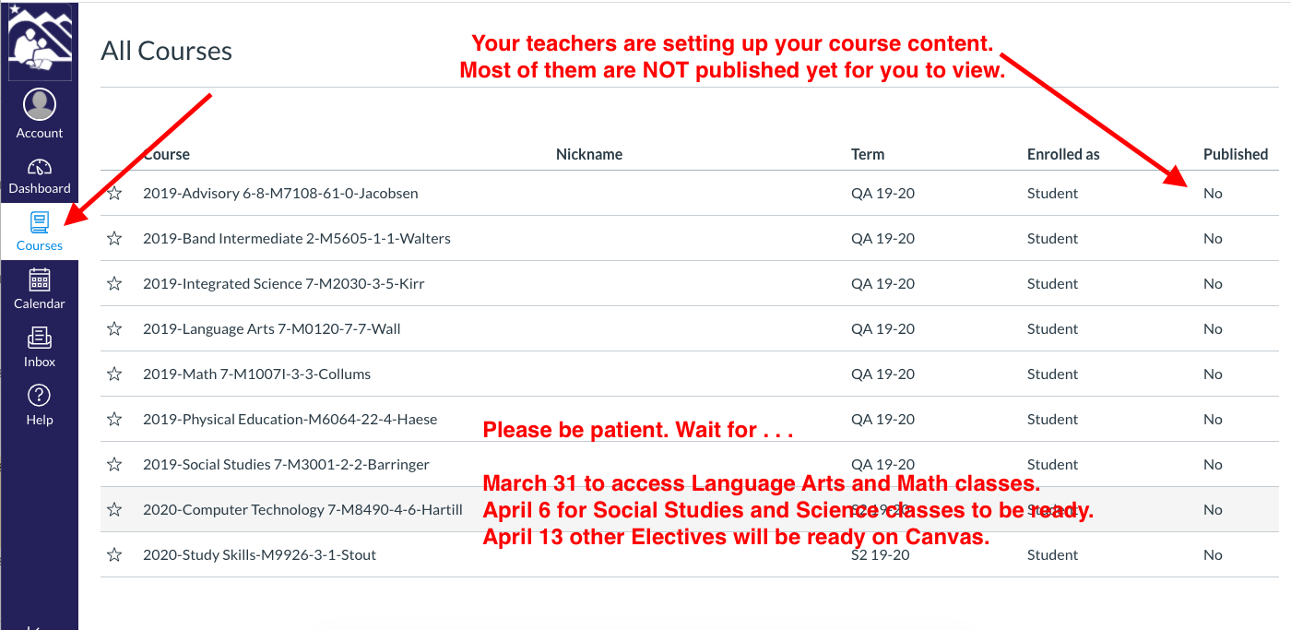
If you click on COURSES, and “All Courses” you will see your school schedule.

Slide 24
On the APP store or Google Play Store:
Search and Install CANVAS Student.
Parents can try Canvas Parent app.

Slide 25
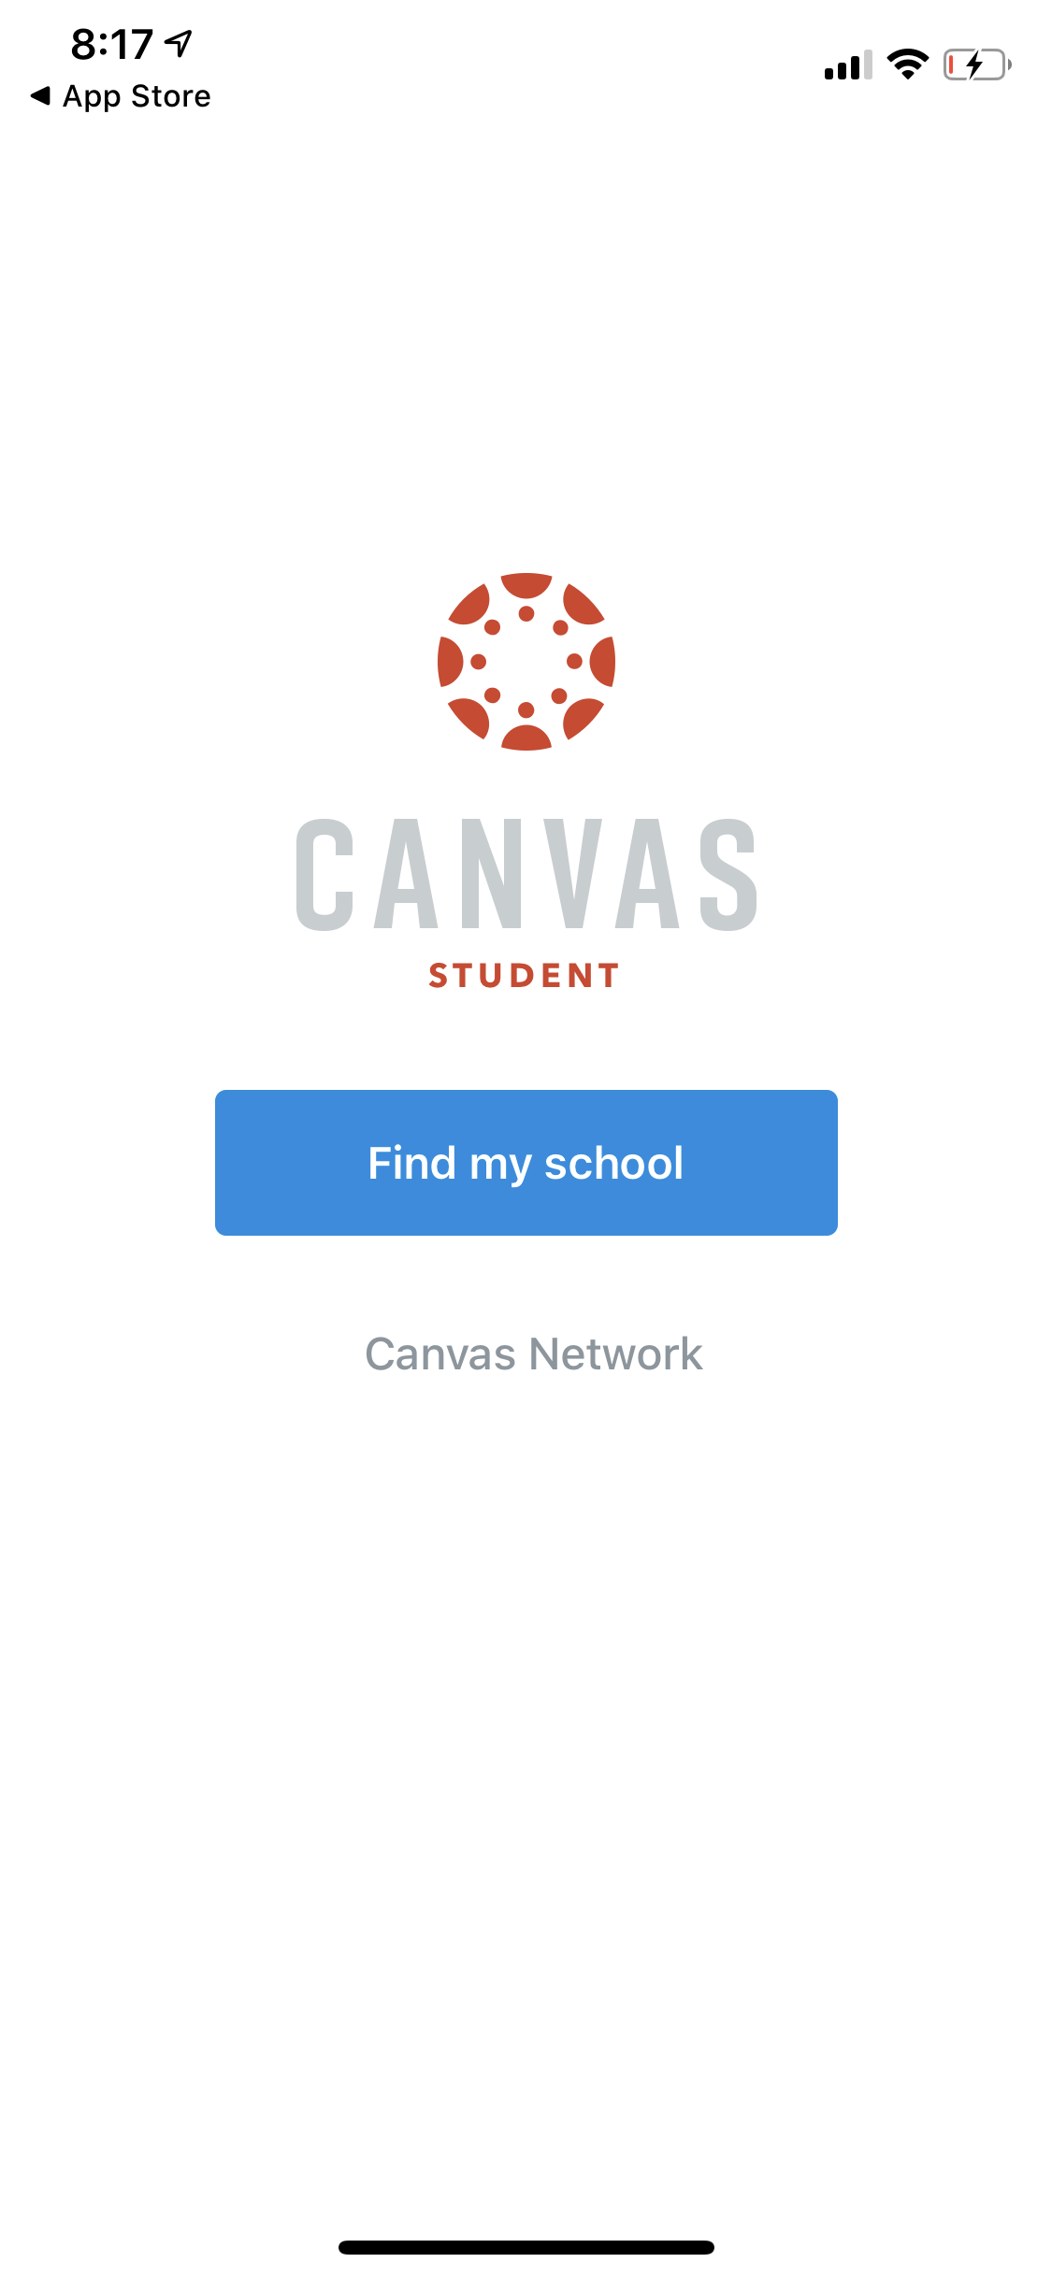
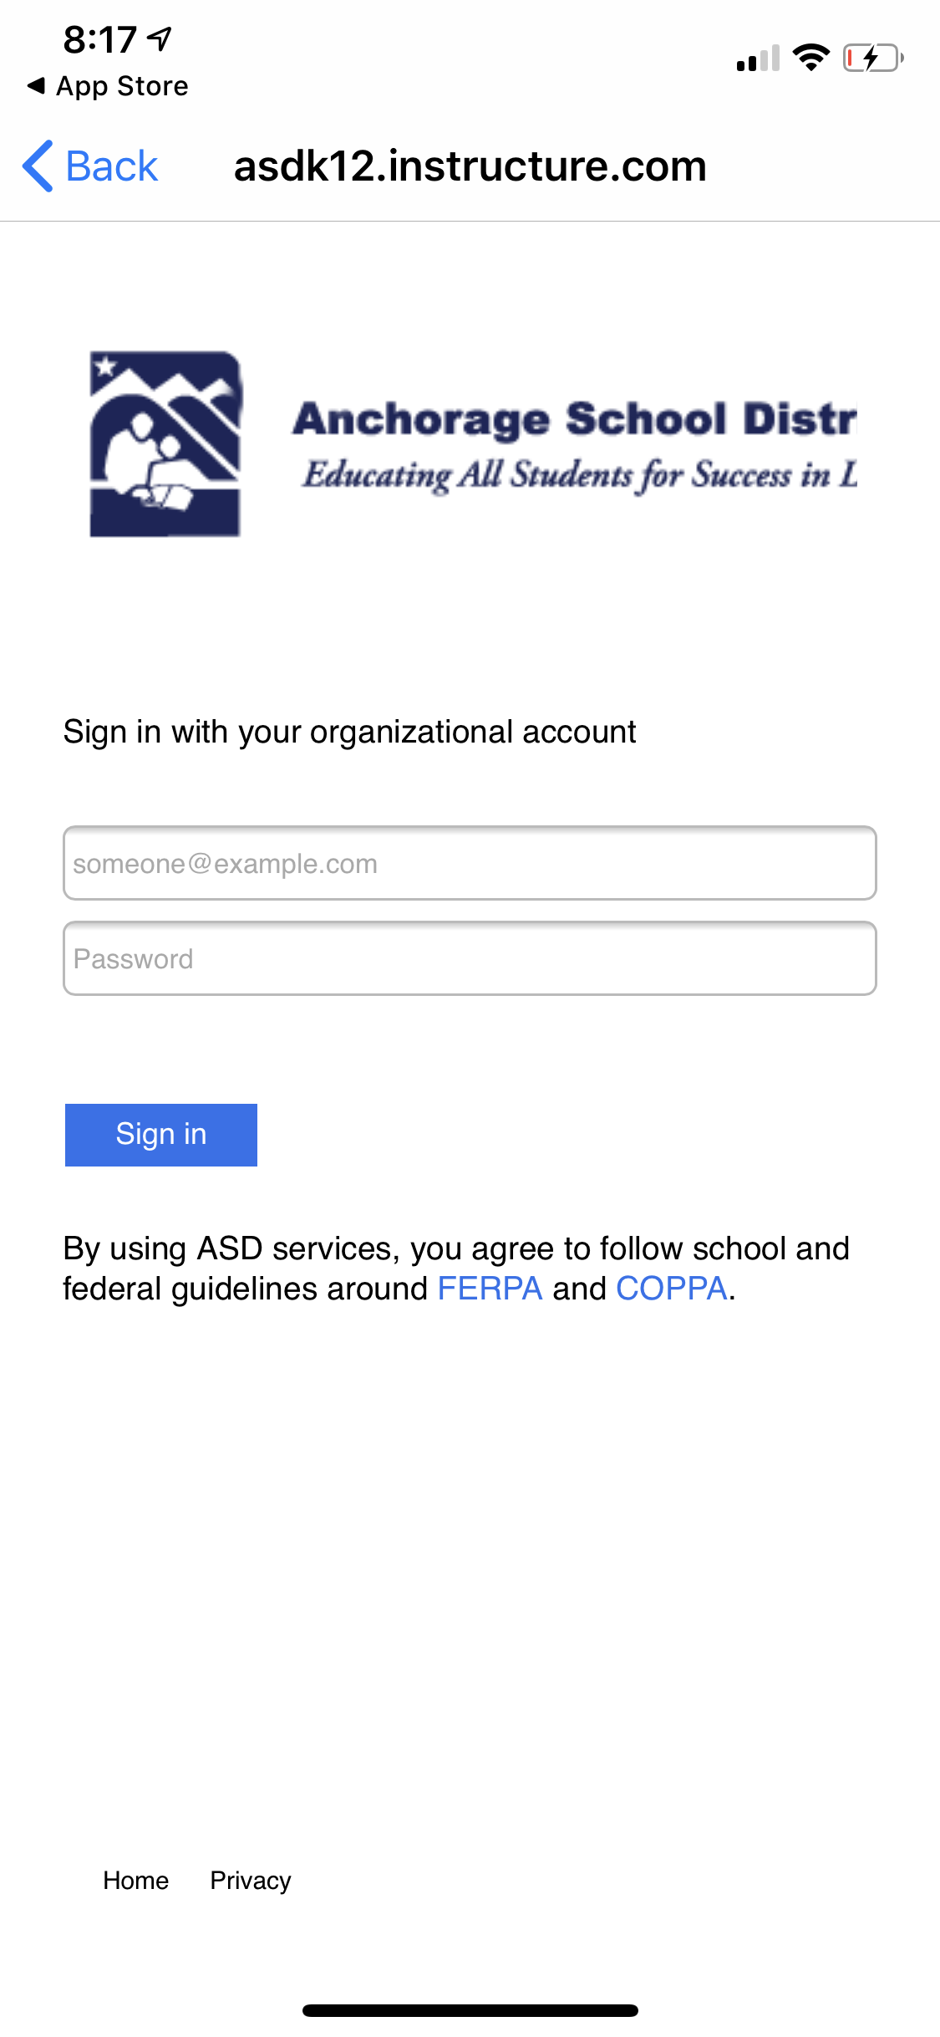
Open Canvas App
Search “Anchorage School District”
Then Login.

Slide 26
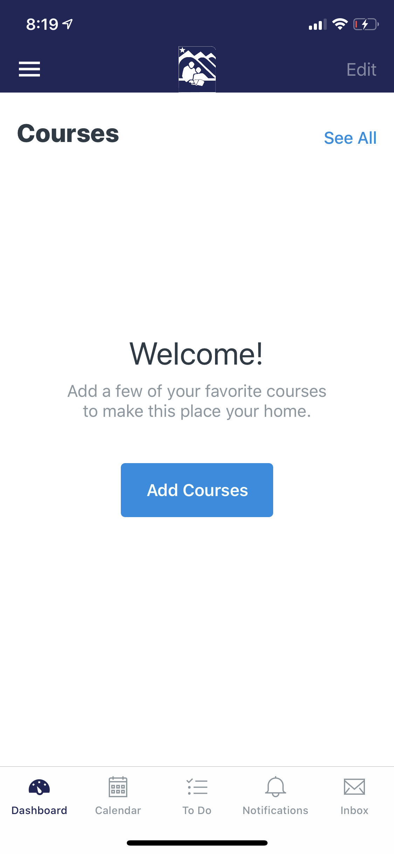
This week, the app will look empty, like you have no courses...

Slide 27
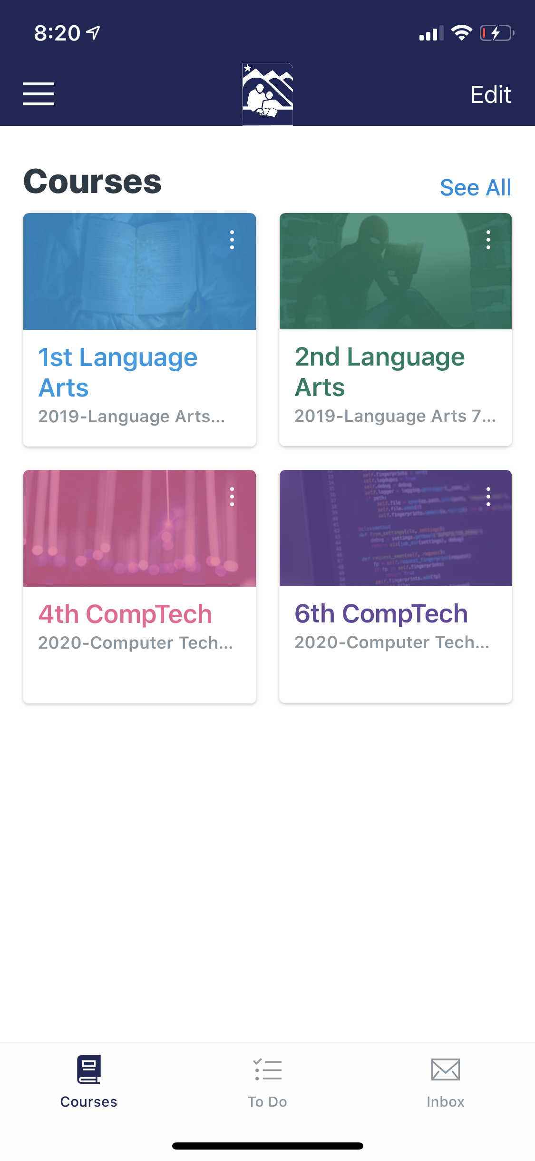
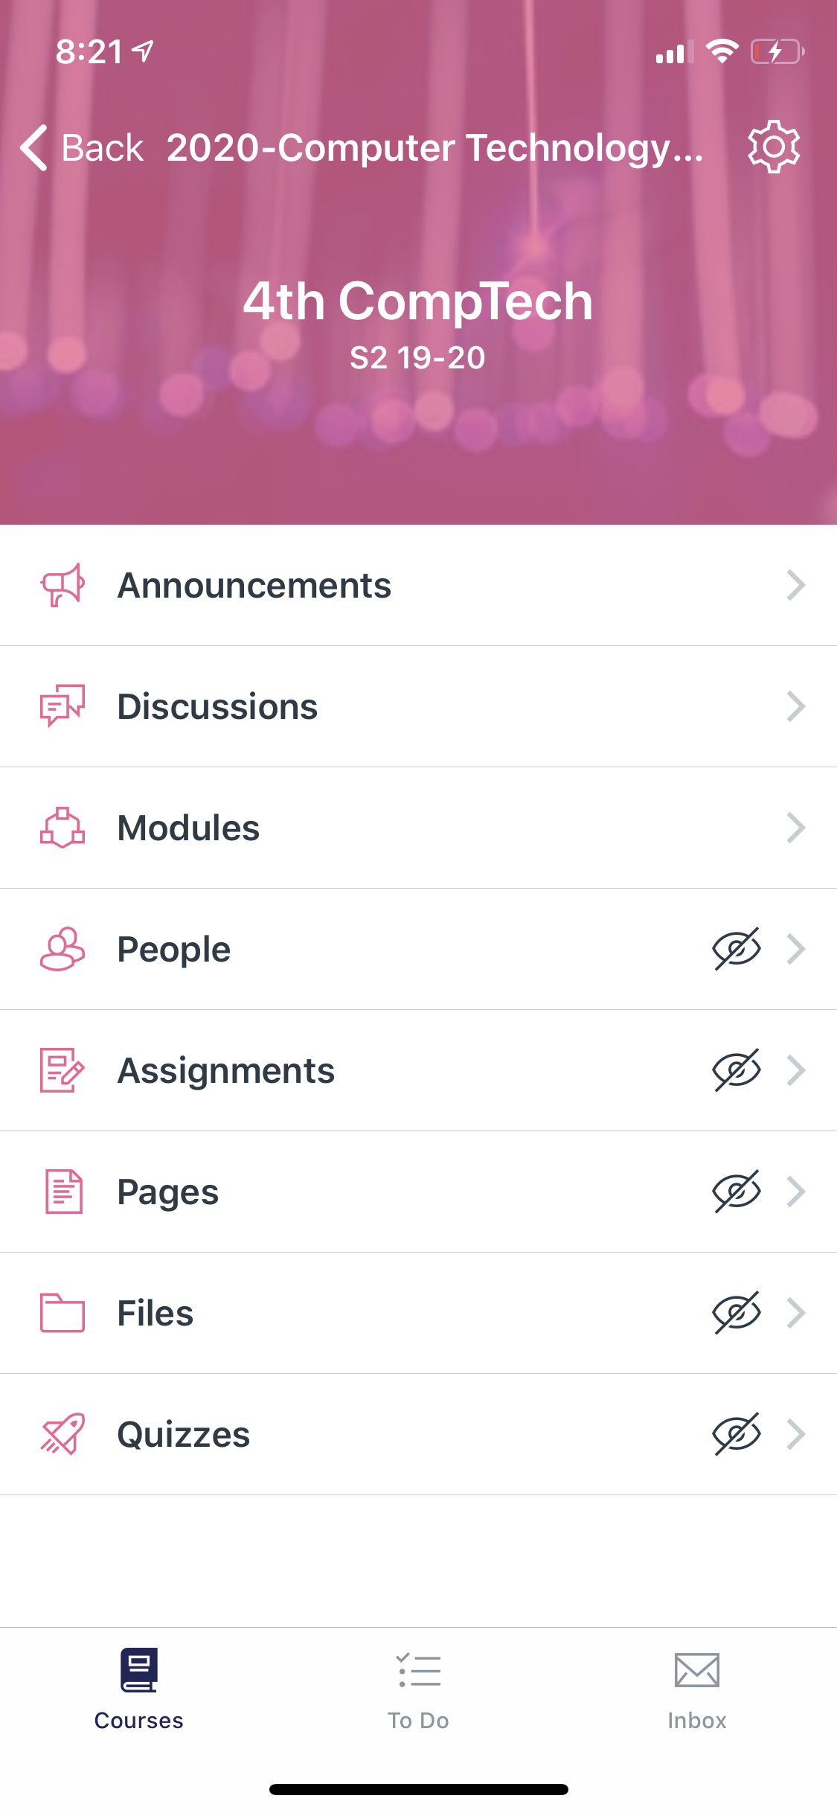
On March 31, you will begin to see your Language Arts and your Math courses.
Here is a look at my Canvas app.
Your classes are currently “hidden” until March 31.

Slide 28
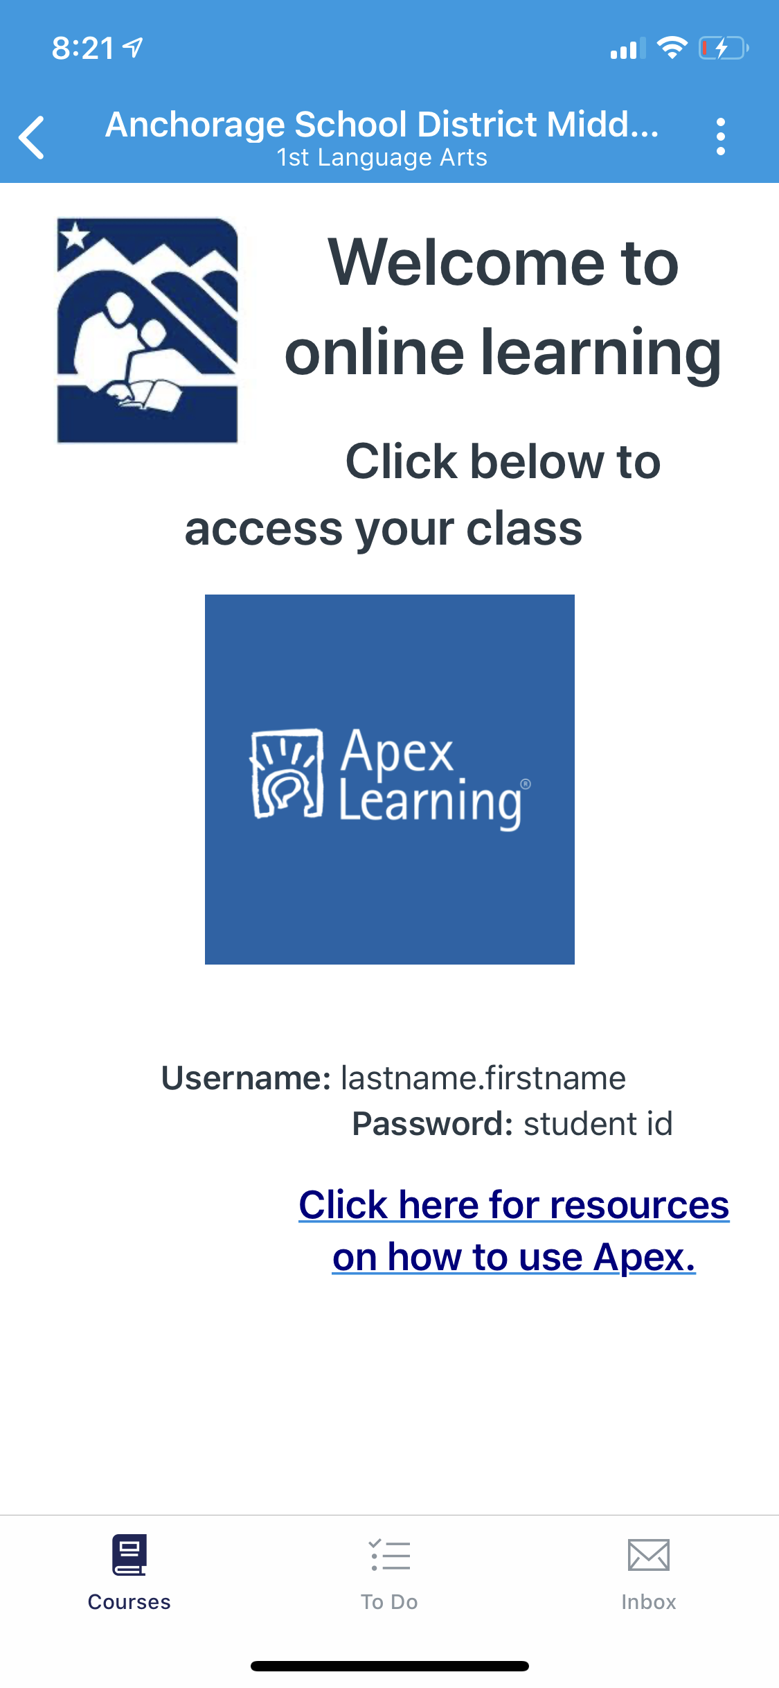
Language Arts class example
Please don’t use your phone to do Apex work. Use a device with a larger screen like a laptop.
Mobile App gives alerts and Announcements about Canvas classes.
You also have an Inbox!

Slide 29
BREATHE

Slide 30
Middle School Classes
March 31 Language Art & Math
All work scored in APEX.
April 6 Science & Social Studies
Activities scored in Canvas
April 13 Electives & CTE
Activities scored in Canvas

Slide 31
 | Monday | Tuesday | Wednesday | Thursday | Friday
8 - 9am | Tutor Sessions for Sped, ELL, Tier II & III
9 - 10am | World Language | P.E. / JROTC | World Language | P.E. / JROTC | World Language
10 -11am | Math | HS Elective | Math | HS Elective | Math
11- 12pm | Language Arts | Fine Arts | Language Arts | Fine Arts | Language Arts
12 -1pm | Science | CTE | Science | CTE | Science
1 - 2pm | Social Studies | MS Electives | Social Studies | MS Electives | Social Studies
2 - 3pm | Tutor Sessions for Sped, ELL, Tier II & III
Notes:
Regular Office Hours on Zoom will be made available by teachers so that students can get tutoring and support in the coursework. Those office hours and links to the zoom meetings will be posted in each course Canvas page.

Slide 32
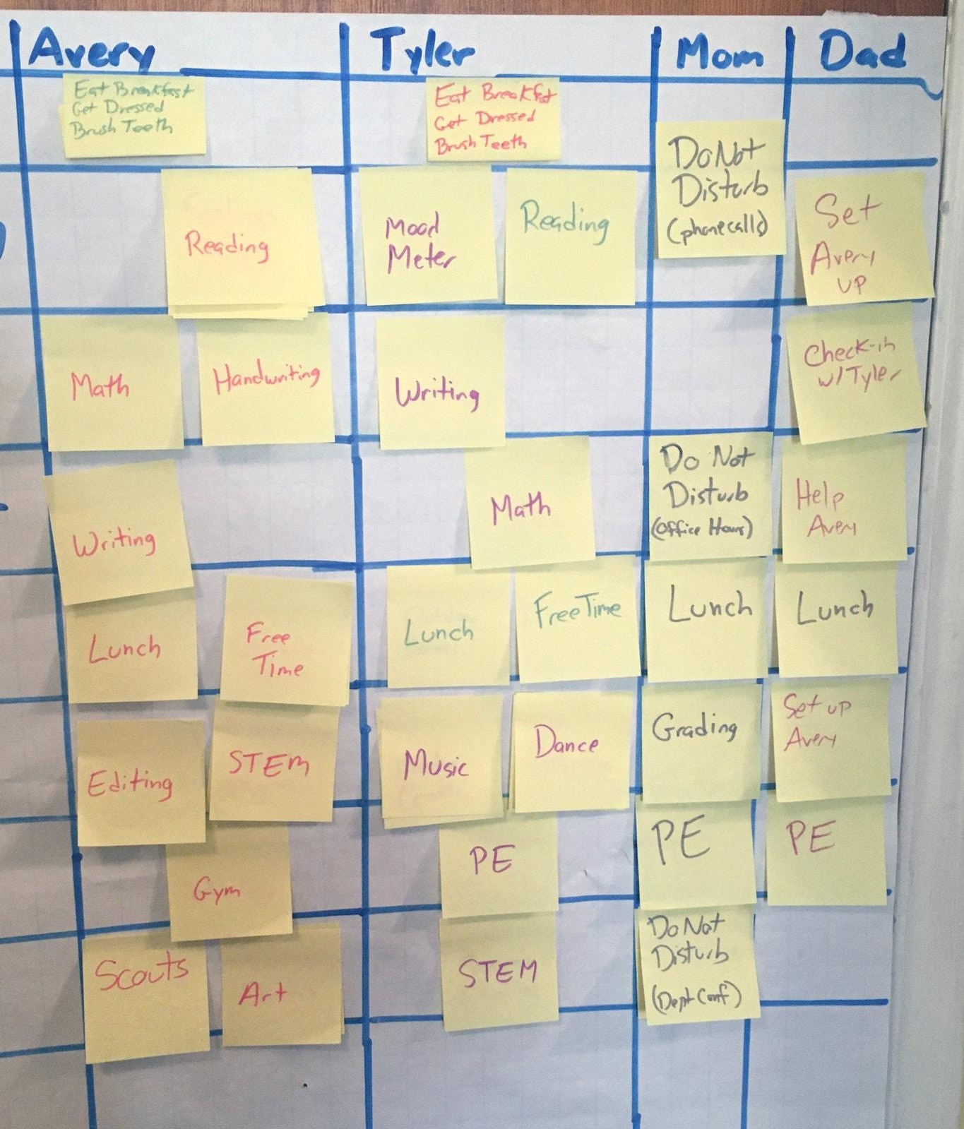
Do you have a planner? A calendar?
Do you have a grid of the week that you can draw out?
What is your typical day schedule like?
How will you stay organized and be able to see at a glance where/when you need to be on Zoom Office Hours with teachers?
How will you balance out family, home, free time, and school work?
Do you have a sibling in high school?

Slide 33
Q Parent Connect
Please remind your folks to update their phone, email, address, and your student email address posted in CONTACTS on Q Parent Connect.

Slide 34
ASD Tech Support for
Parents & Students
https://help.asdk12.org

Slide 35
Academic Priorities
Focus on Math and Language Arts.
These assignments are all in Apex.
Link to Apex also in your Canvas course tiles for Math and Language Arts.

Slide 36
TAKE A MOMENT
TO BREATHE

Slide 37
Chugiak Elementary
Homestead Elementary
Fire Lake Elementary
More Locations & Information
Meals Pick-Up
10:00 - 2:00

Slide 38
COVID-19 Resources
ASD Family Resources
Anchorage Municipality Dial 211
Johns Hopkins University
Alaska Department of Health
U.S. Center for Disease Control & Prevention

Slide 39
Stay Healthy

